Slide 1

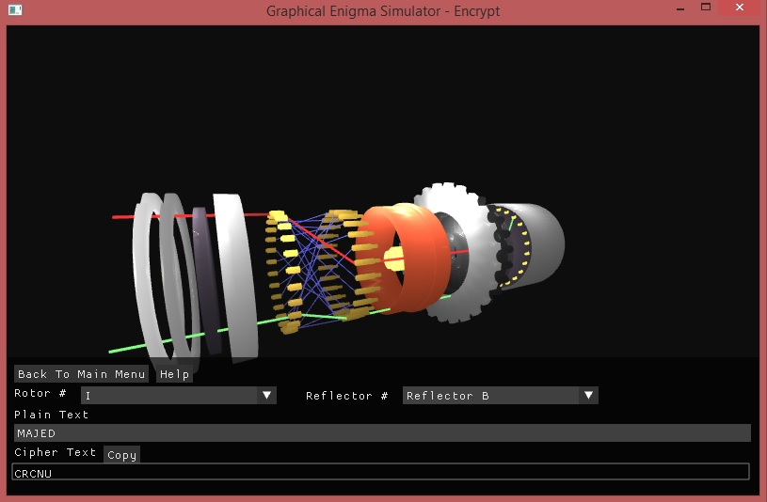
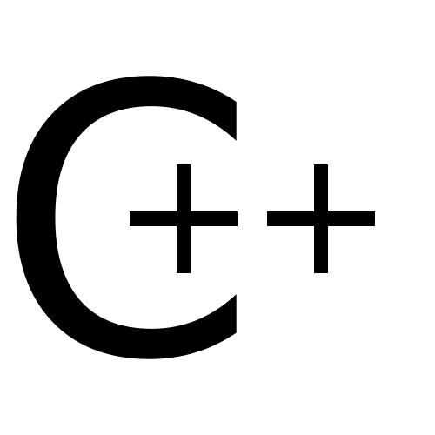


Graphical Enigma Simulator
Majed Monem
Prof. John Arnott
Enigma machines were used in the main during World War II by the German military. It was a device which encrypted plain text into ciphered text. In this project an Enigma simulator was developed.
Create a QR code for your page on the Degree Show website and place it in this location (3cm x 3cm)
The simulator demonstrates the process of encryption and decryption via one rotor. OpenGL and C++ was used to create the simulator along with Blender, which was used to create the rotor components.
Please save as a PowerPoint 97-2003 format file named <YourFirstNameYourSurname2014.PPT> and e-mail it to irmurray@computing.dundee.ac.uk for printing.
Do not allow any text, image or shadow to go below this level
Do not allow any text, image or shadow to go below this level

